Slide 1


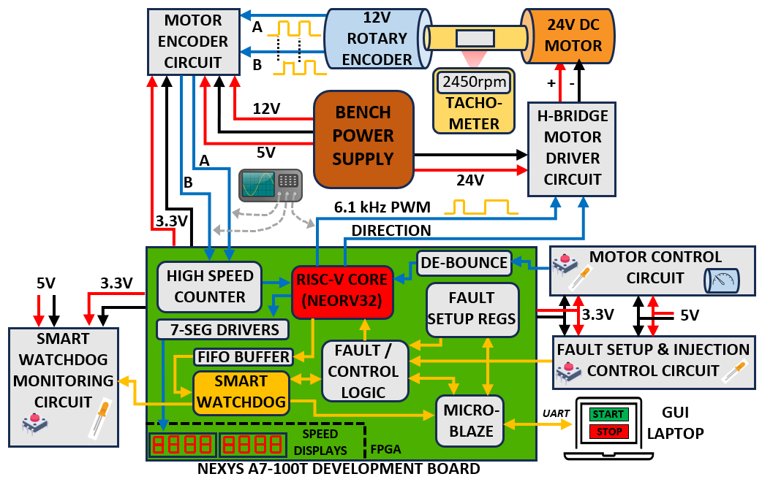
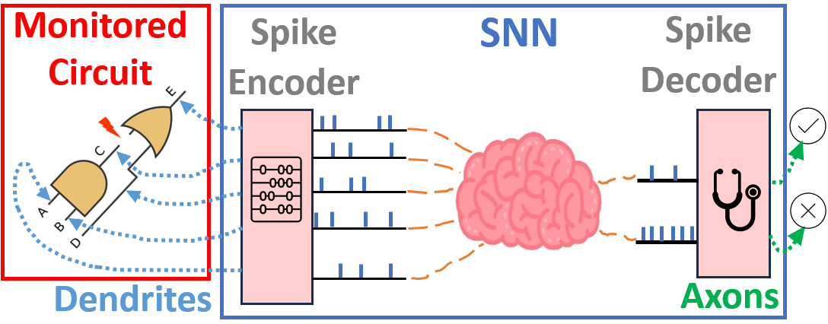


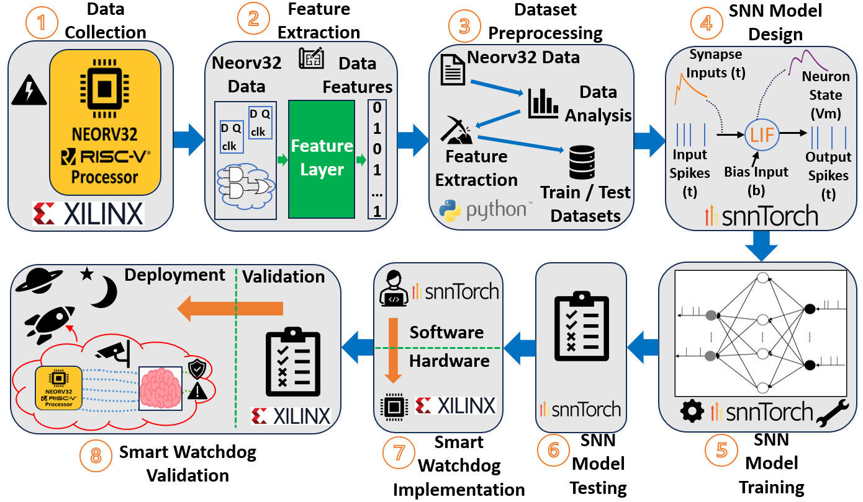
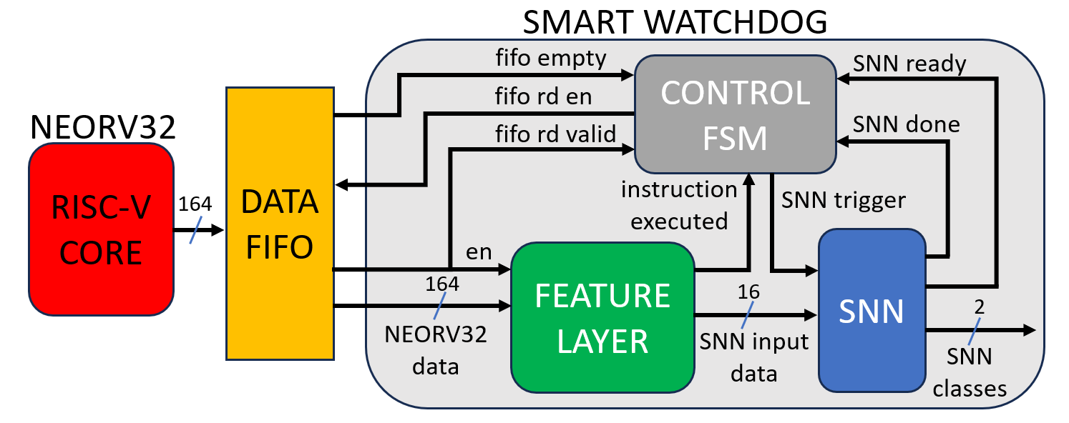





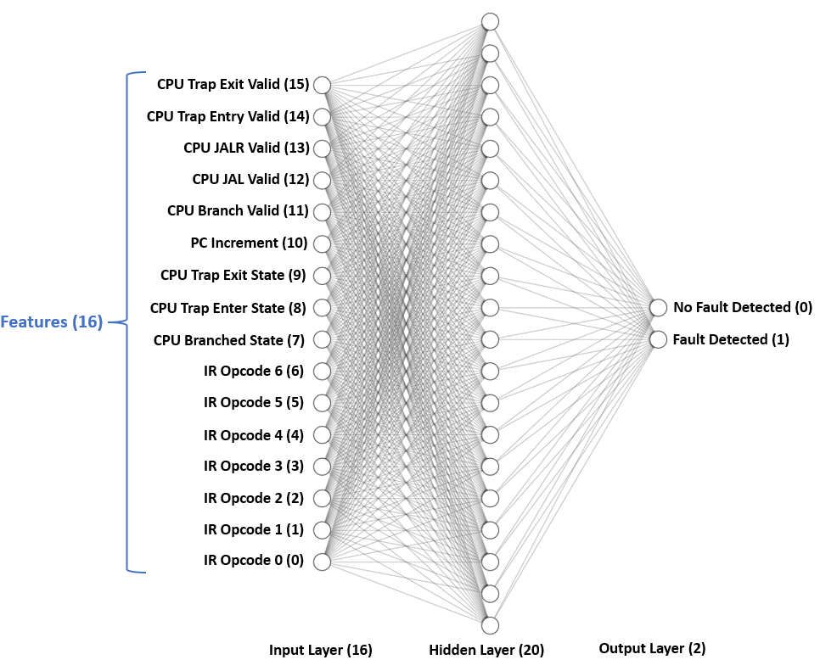
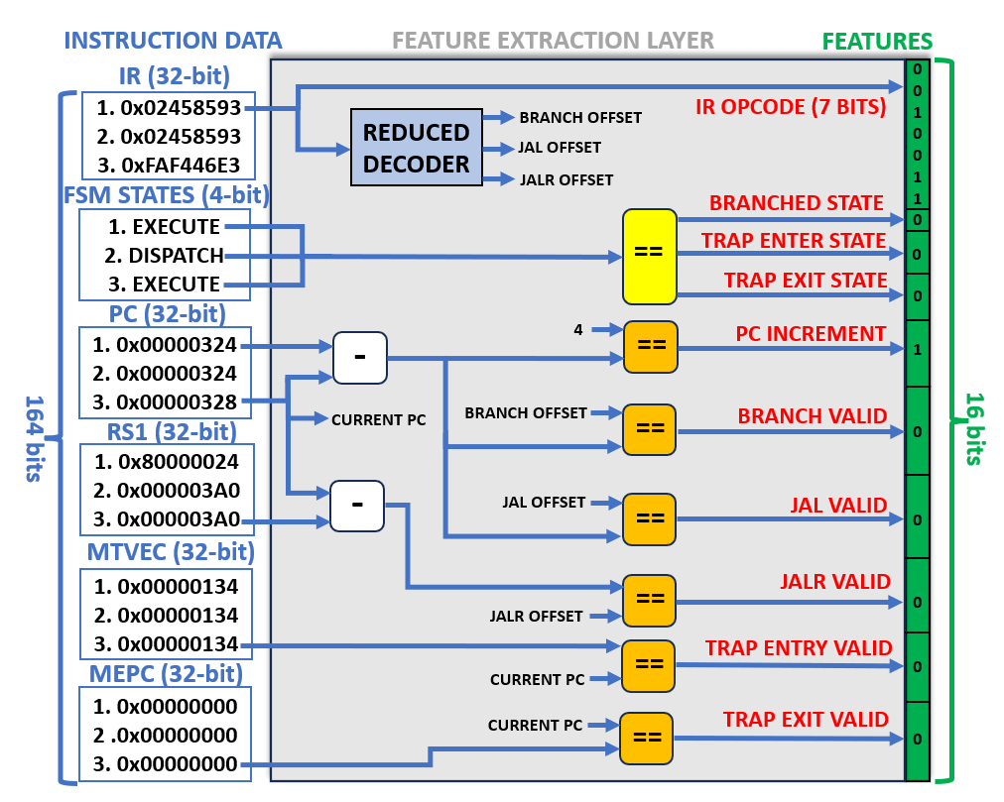
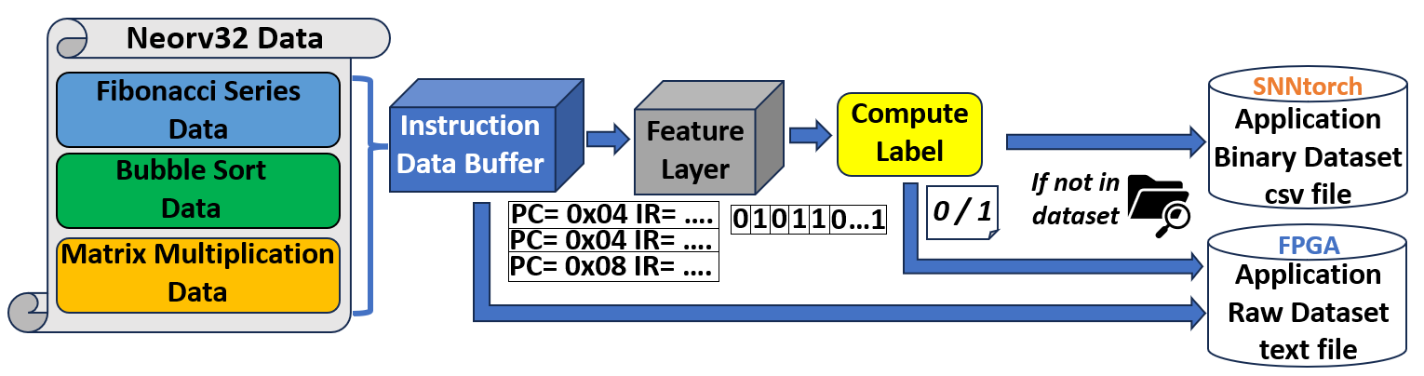
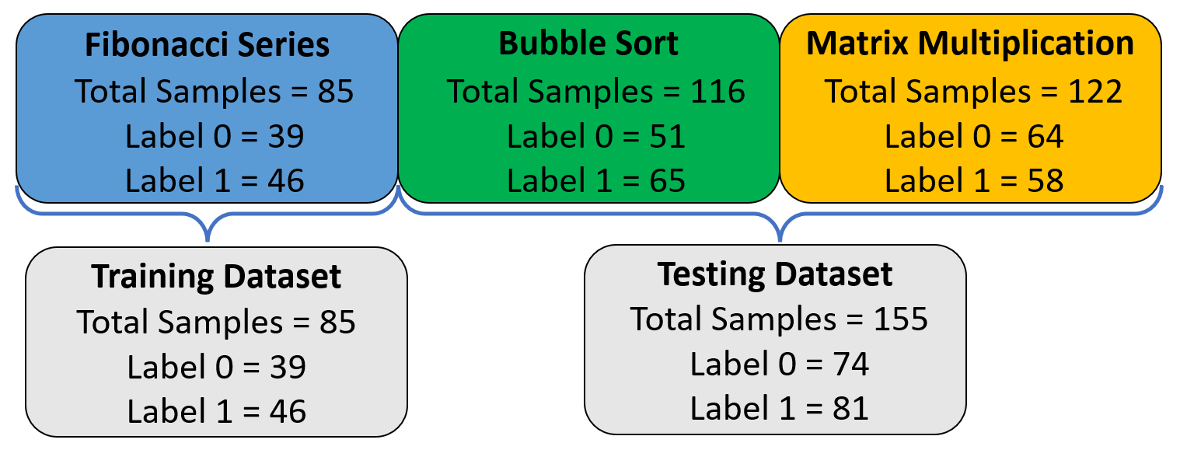




Smart Watchdog Mechanism for
Real-time Fault Detection in RISC-V
PhD Supervisors:
Prof Jim Harkin
Mr Malachy McElholm
Prof Liam McDaid
School of Computing, Engineering and Intelligent Systems,
Ulster University, Derry, UK
David Simpson
simpson-d12@ulster.ac.uk
Background
Live Demonstration (FPGA)
Error checking in modern processors is critical¹.
🚀
Detection mechanisms (watchdogs) must exhibit minimal area overhead and power consumption².
RISC-V processor executes a closed-loop PI control algorithm on a DC motor and rotary quadrature encoder.
Spiking Neural Networks (SNNs) could offer a more hardware friendly and efficient implementation³.
Faults are injected at the program counter register of RISC-V processor.
SNN-based Smart Watchdog
Smart watchdog decisions observed in detail on a custom Python-based GUI.
SNN trained to detect control flow errors (CFEs) caused by hardware faults in a RISC-V processor⁴.
Nexys A7-100T development board (AMD Artix-7 FPGA) used as hardware platform for live demonstration.
Smart Watchdog Aims:
- Smarter watchdog paradigm
See Github page for full details.
- Lower power consumption
- More hardware friendly
Methodology
Stage 8 – Smart Watchdog Validation
8-stages to develop a smart watchdog to monitor a RISC-V processor.
Validation Dataset: Heap Sort (new application)
Smart Watchdog Fault Detection Capability
Samples | Correct | TP | TN | FN | FP
100 | 98 | 46 | 52 | 2 | 0
Accuracy |  | Precision | Recall | F1 Score
0.98 |  | 1.00 | 0.96 | 0.98
Total Heap Sort Applications | Applications with Control Flow Errors | Applications with Traps Triggered | Smart Watchdog Detection
1,000 | 840 | 490 (58.3%) | 350 (100%)
New Samples from Heap Sort: 11/11
(100% accuracy)
Smart watchdog detected all CFEs that were undetected in the RISC-V processor.
Stage 7 – Smart Watchdog Implementation
Max Freq:
350MHz
Hardware Synthesis Results
Latency: 153 cycles
Component | FFs | LUTs | Power (W)
Neorv32 | 1,993 | 1,874 | 0.027
Feature Layer | 149 | 157 | 0.001
SNN | 8,928 | 6,494 | 0.142
Smart W-dog | 10,264 | 6,733 | 0.143
AMD VC-709 (Virtex-7) FPGA used in this work.
Inference:
438ns
Stage 1 – Data Collection
Stage 6 – SNN Model Testing
Stage 5 – SNN Model Training
Fibonacci Series, Bubble Sort and Matrix Multiplication software applications were executed on RISC-V processor.
Testing Dataset: Bubble Sort &
Matrix Multiplication
Training Dataset: Fibonacci Series
Samples | Correct | TP | TN | FN | FP
155 | 152 | 78 | 74 | 3 | 0
Accuracy |  | Precision | Recall | F1 Score
0.98 |  | 1.00 | 0.96 | 0.98
Parameter | Value
Network Type | Binary Classifier
Learning Type | Supervised
Development Library | SNNTorch⁵ (PyTorch)
Epochs | 400
Optimizer | Adam
Batch Size | 1
Loss Function | Mean Square Error
Learning Scheduler Rates | 0.1 / 0.01 / 0.001
Learning Rate Milestones | 10 / 200
Faults were injected into the Program Counter register (PC) of RISC-V processor during execution.
Instruction data from RISC-V processor was extracted via UART and stored as text files (serial terminal).
Seen Test Samples at Training: 80/80
(100% accuracy)
Builds a library of normal instructions and faulty instructions to train the SNN of the smart watchdog.
Unseen Test Samples During Training: 72/75
(96% accuracy)
Stage 2 – Feature Extraction
Stage 3 – Dataset Preprocessing
Stage 4 – SNN Model Design
Features are extracted from each instruction executed, capturing information on control flow.
Datasets are pre-processed and produced for each of the three applications as shown below.
CPU Trap Exit Valid (15)
CPU Trap Entry Valid (14)
CPU JALR Valid (13)
CPU JAL Valid (12)
CPU Branch Valid (11)
PC Increment (10)
CPU Trap Exit State (9)
CPU Trap Enter State (8)
Fault Detected (1)
Training and testing datasets are used to develop the SNN model of the smart watchdog.
CPU Branched State (7)
No Fault Detected (0)
IR Opcode 0 (6)
IR Opcode 1 (5)
Output
Layer
(2)
IR Opcode 2 (4)
IR Opcode 3 (3)
IR Opcode 4 (2)
IR Opcode 5 (1)
IR Opcode 6 (0)
Input
Layer
(16)
Hidden Layer (20)

